Slide 1

Somos un ecosistema de desarrolladores de software

Slide 2
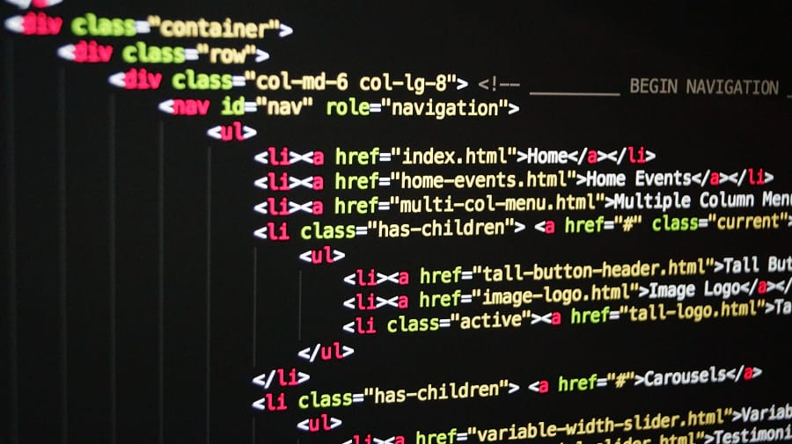


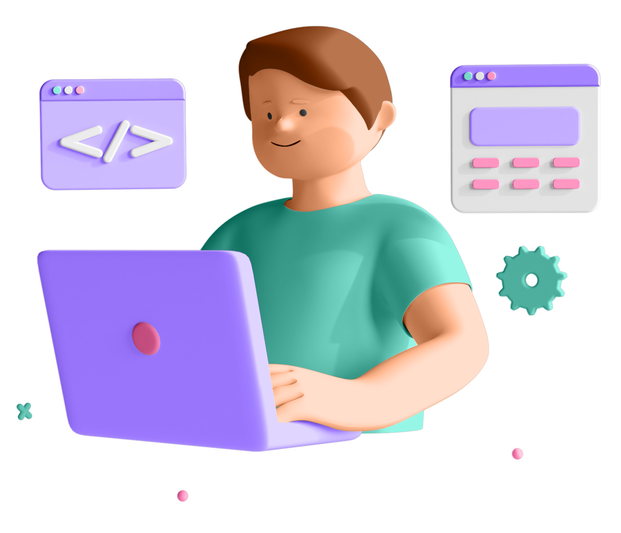

Java Script POO (Document Object Model)

Slide 3

POO
Object-oriented programming ( OOP)
➢ Object-oriented programming (OOP) is a programming paradigm based on the concept of objects;
➢ We use objects to model (describe) real-world or abstract features;
➢ Objects may contain data (properties) and code (methods). By using objects, we pack data and
the corresponding behavior into one block;
➢ In OOP, objects are self-contained pieces/blocks of code;
➢ Objects are building blocks of applications, and interact with one another;
➢ Interactions happen through a public interface (API): methods that the code outside of the object
can access and use to communicate with the object;
➢ OOP was developed with the goal of organizing code, to make it more flexible and easier to
maintain (avoid “spaghetti code”).

Slide 4

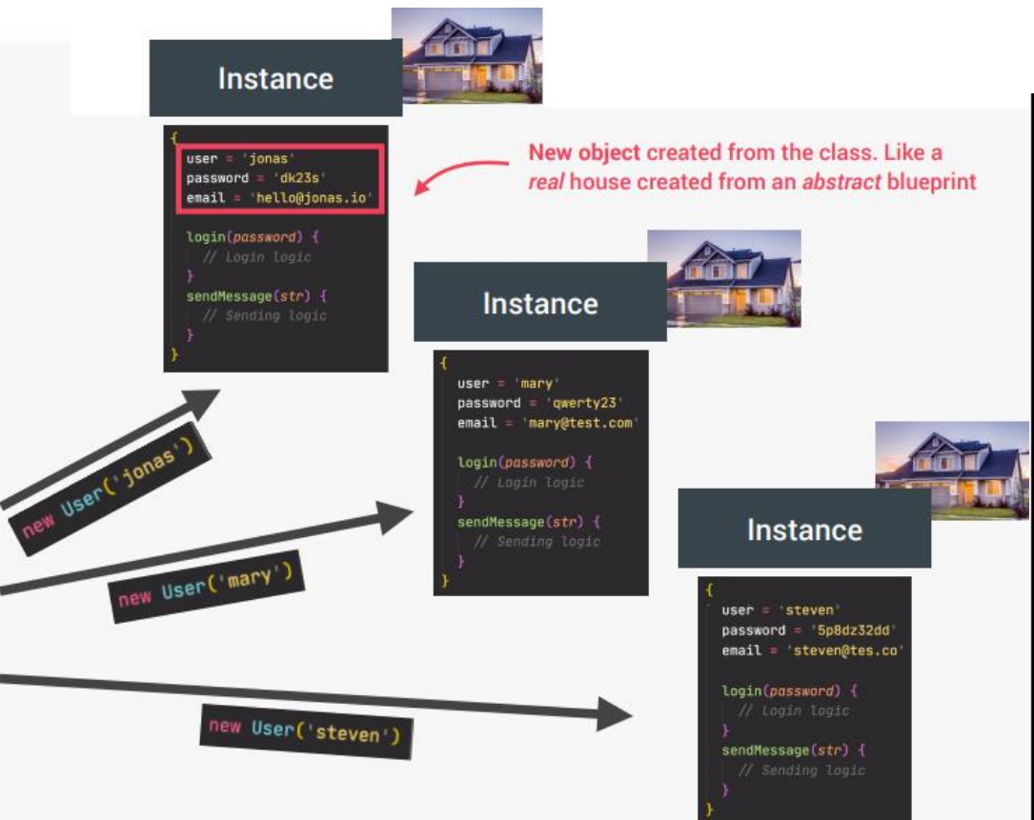
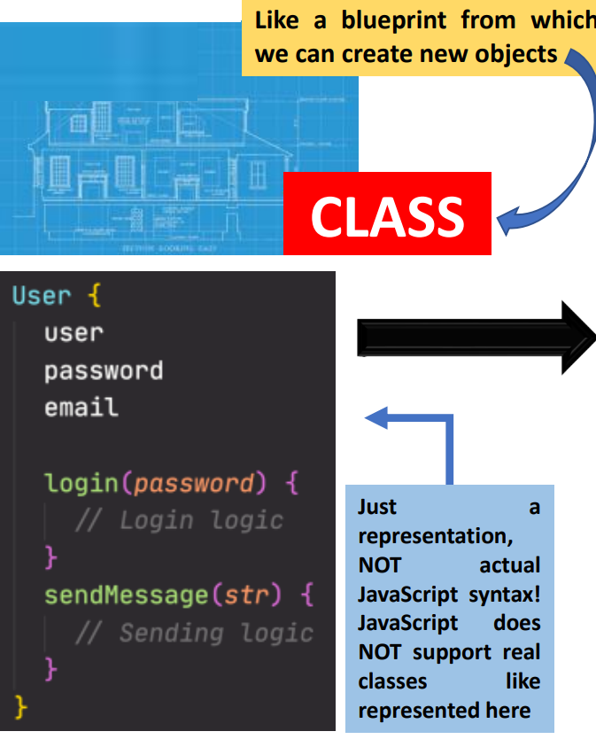
POO
Classes and instances (Traditional OPP)

Slide 5
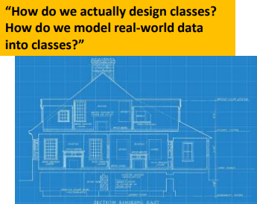








POO
The 4 fundamental OOP principles
ENCAPSULATION
POLYMORPHISM
ABSTRACTION
INHERITANCE

Slide 6
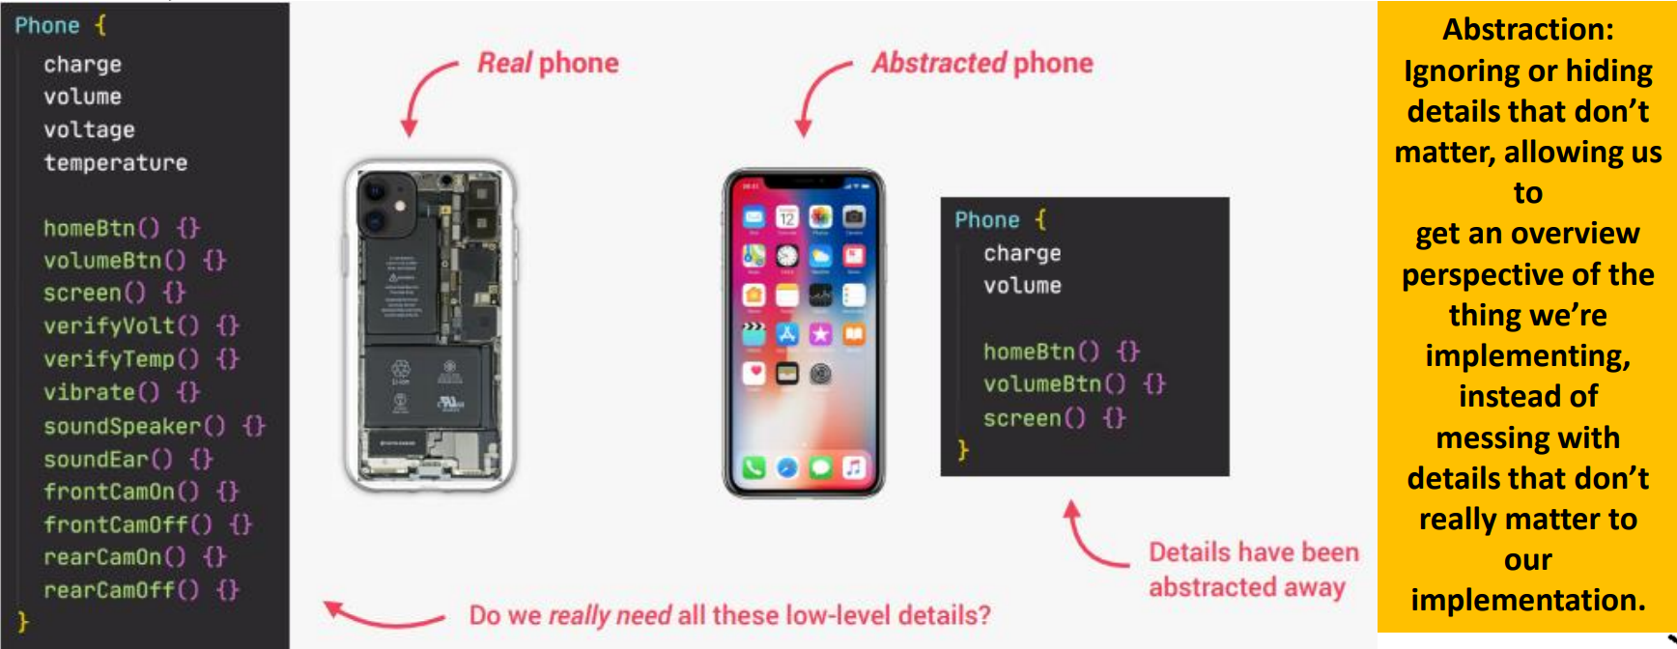
POO
ABSTRACTION

Slide 7
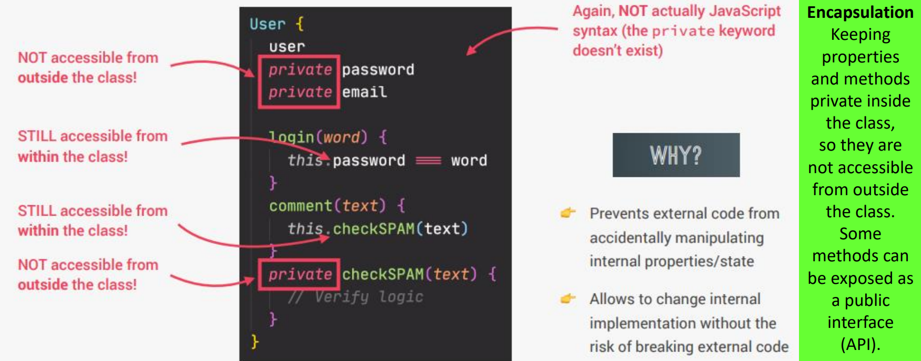
POO
ENCAPSULATION

Slide 8
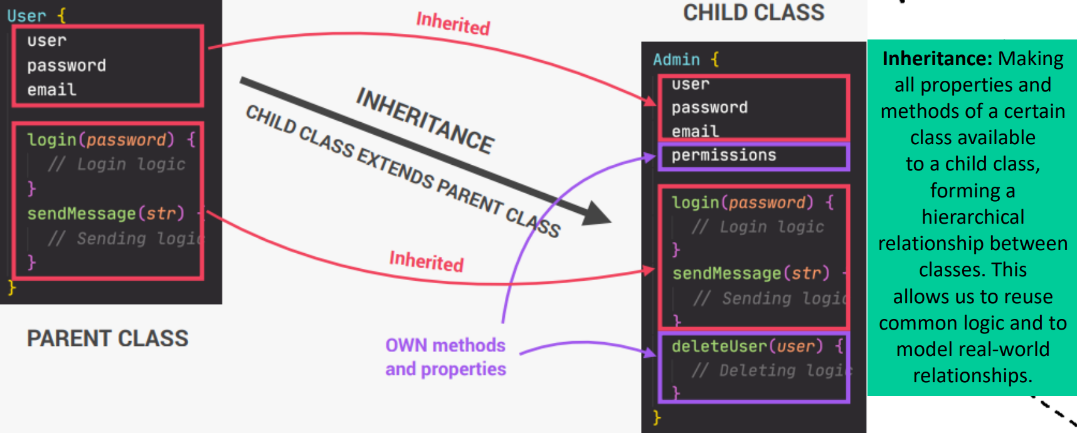
POO
INHERITANCE

Slide 9
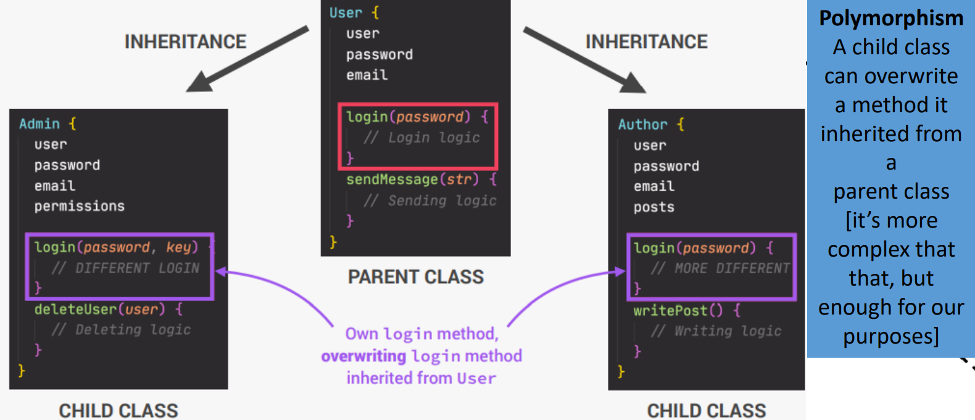
POO
POLYMORPHISM

Slide 10


